Slide 1
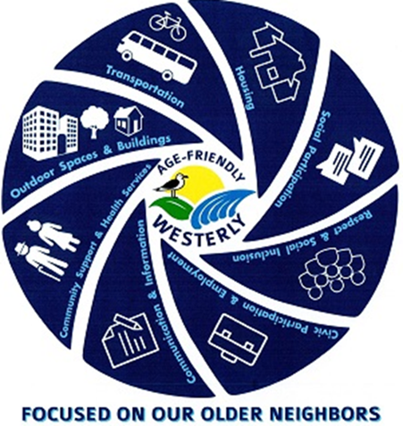
Age Friendly Westerly
Lindsey Greene-Upshaw
Regional Lead Westerly Hospital, Yale New Haven Health
Melissa Sigua
Community Health Project Coordinator, Westerly Hospital, Yale New Haven Health
January 22, 2026

Slide 2

01
Background
02
Community Health Needs Assessment
Agenda
03
Workgroups
04
Summary of Work to Date
05
Lessons Learned

Slide 3

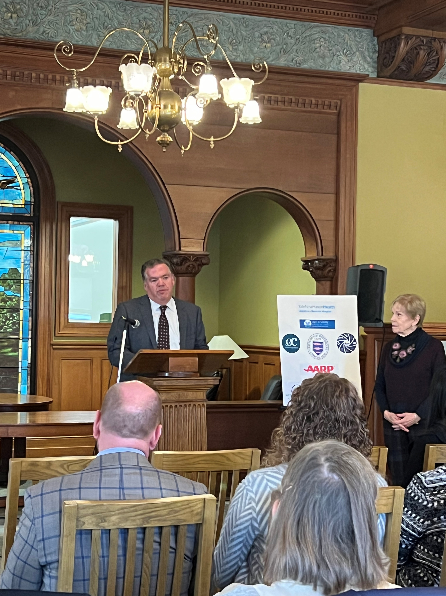
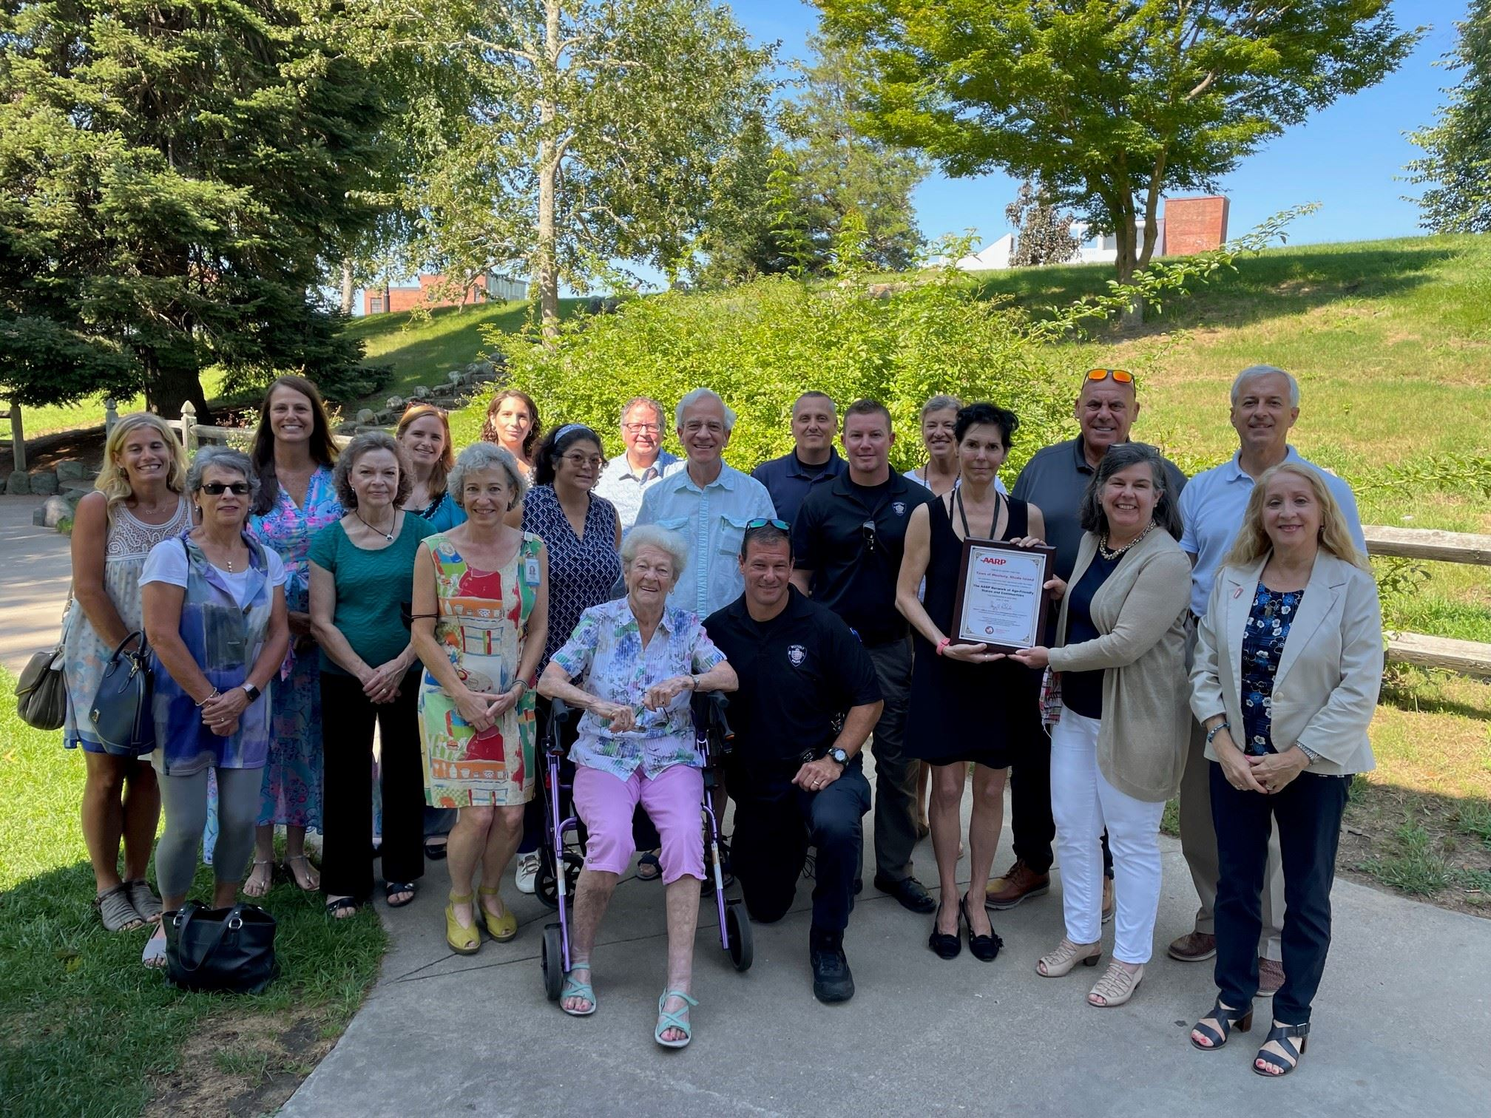
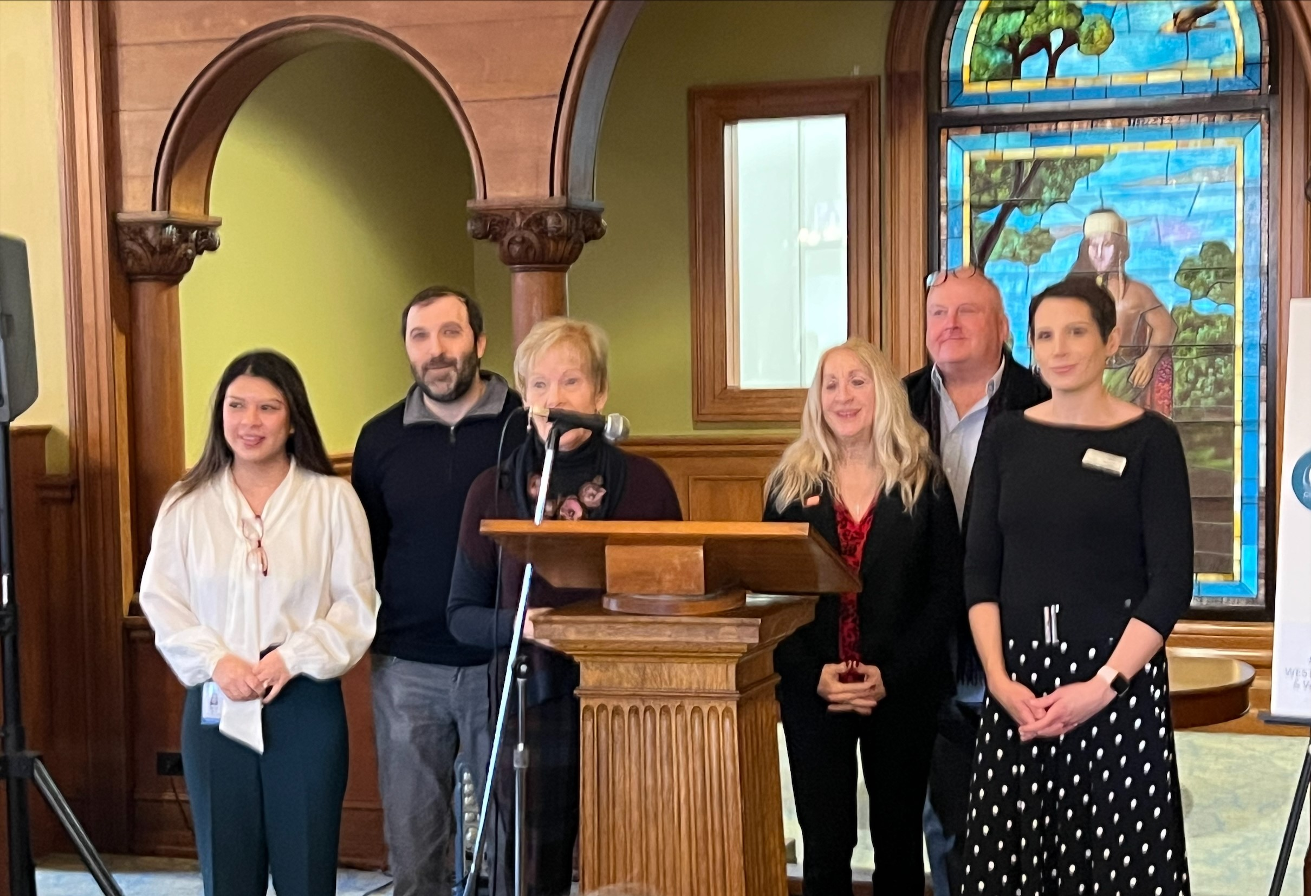
Background
CHNA Catalyst
Facilitation from Westerly Hospital
Joined AARP Network in 2021
Action Plan accepted in 2024
Notes:
The 2019 Community Health Needs Assessment of Greater Westerly catalyzed the convening and commitment of community leaders.
Age Friendly Westerly is made of community leaders and members, supported by Age Friendly RI and facilitated by Yale New Haven Health Office of Health Equity & Community Impact (OHECI).
The Town of Westerly joined the AARP Network in 2021 and committed to a multi-year, multi- phase process to make the community a place for all ages, a community inclusive and welcoming.
AARP has officially accepted the Age Friendly Westerly Action Plan November 2024 for becoming more age friendly under the criteria established by AARP.

Slide 4
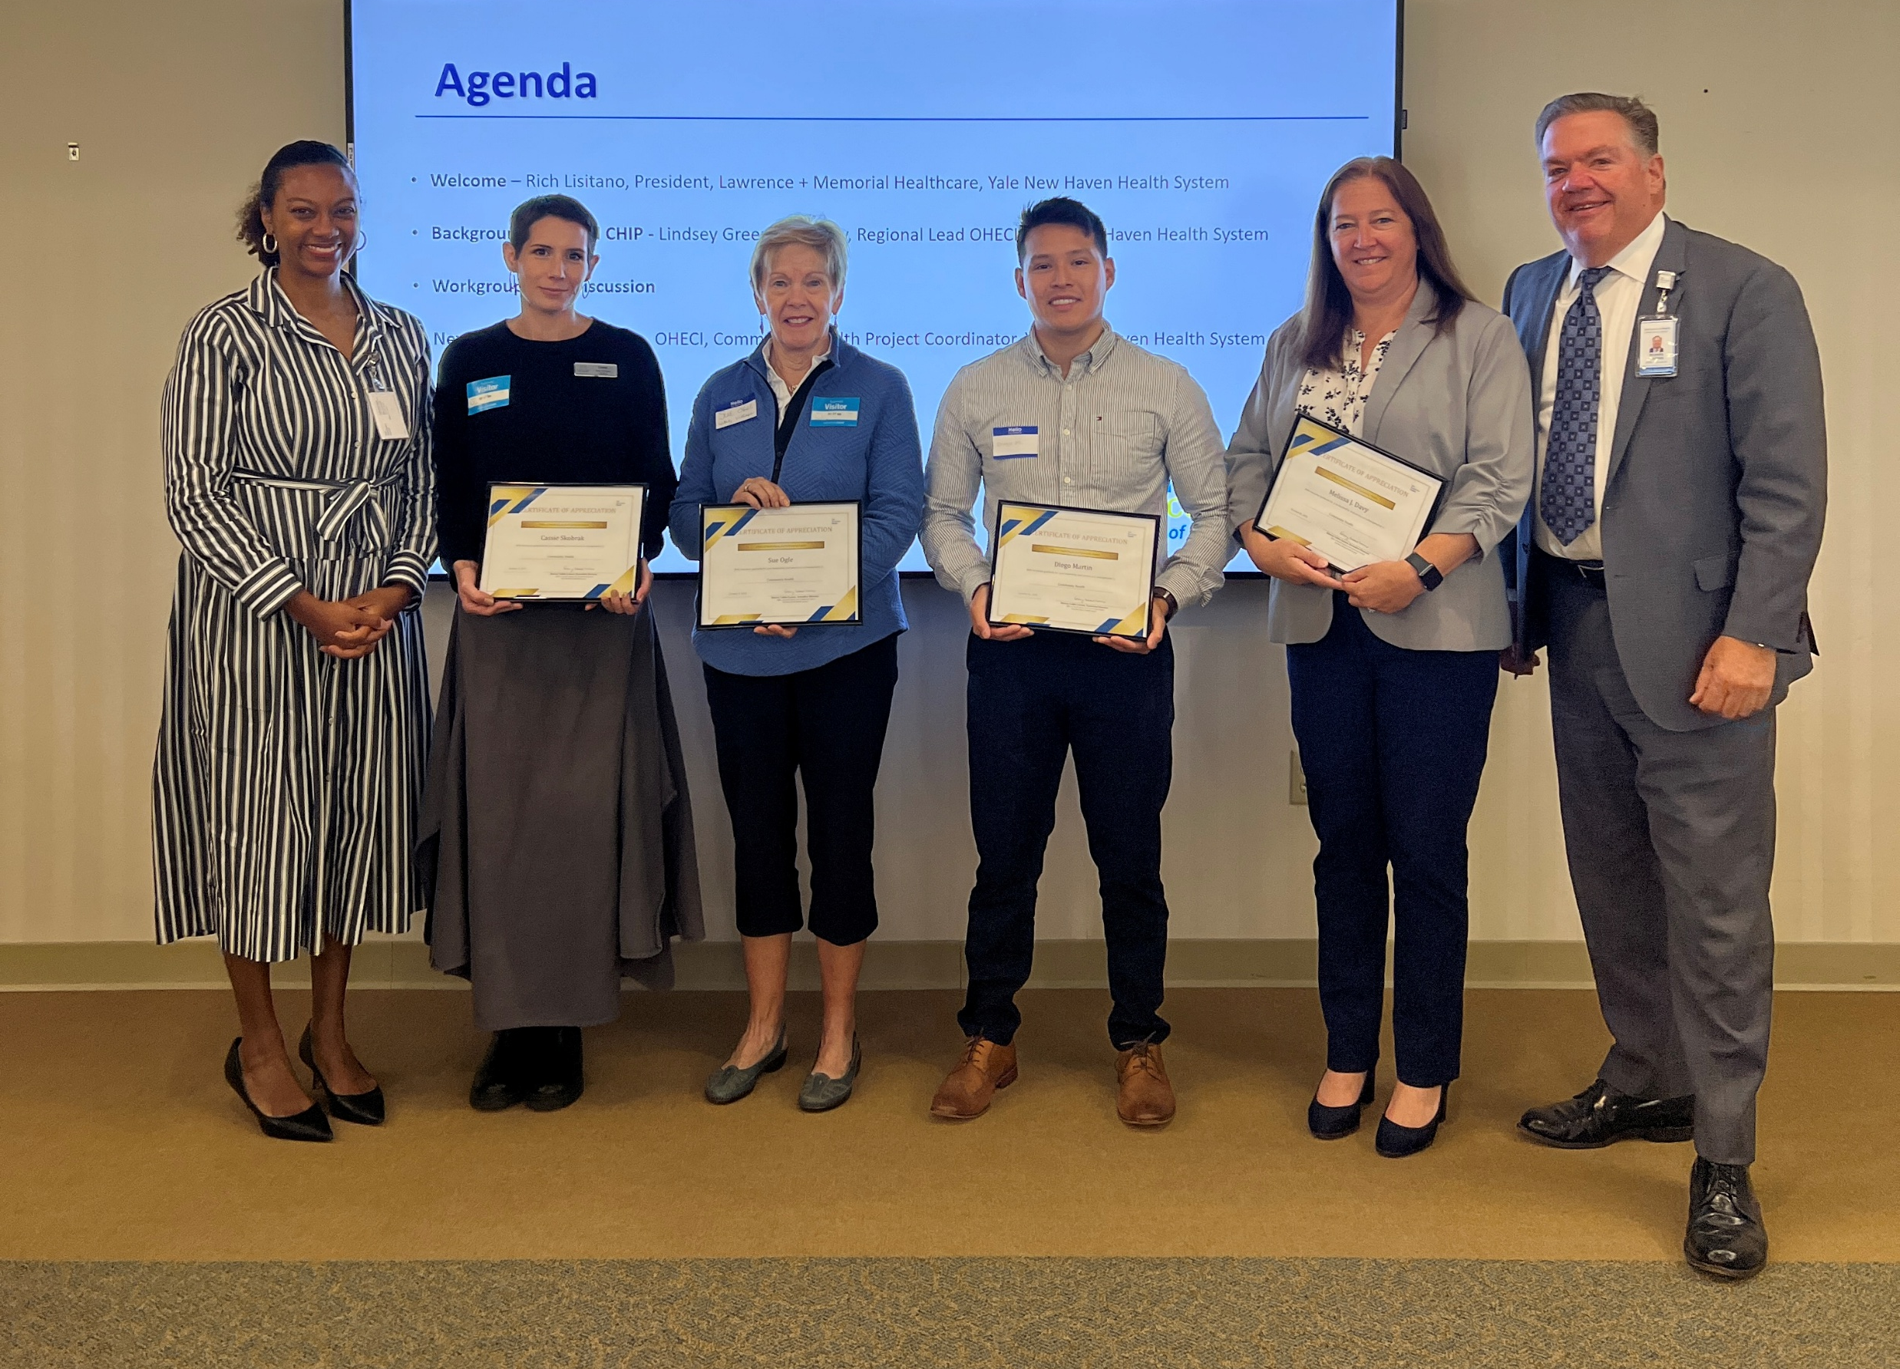
Community Health Needs Assessment
Health Improvement Collaborative
IRS requirement for hospitals to maintain nonprofit status
Conducted in collaboration with the Hospital Association of Rhode Island (HARI)
Two parts, 1) Community Health Needs Assessment and 2) Implementation Strategy Plan (ISP) or Community Health Implementation Plan
Provides a roadmap for health priorities, goals and actions in a community

Slide 5
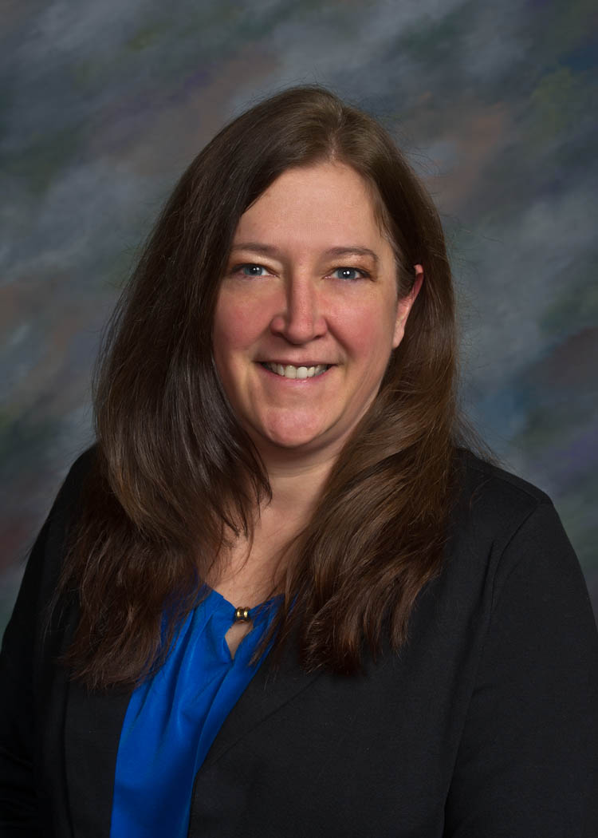
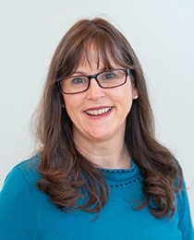
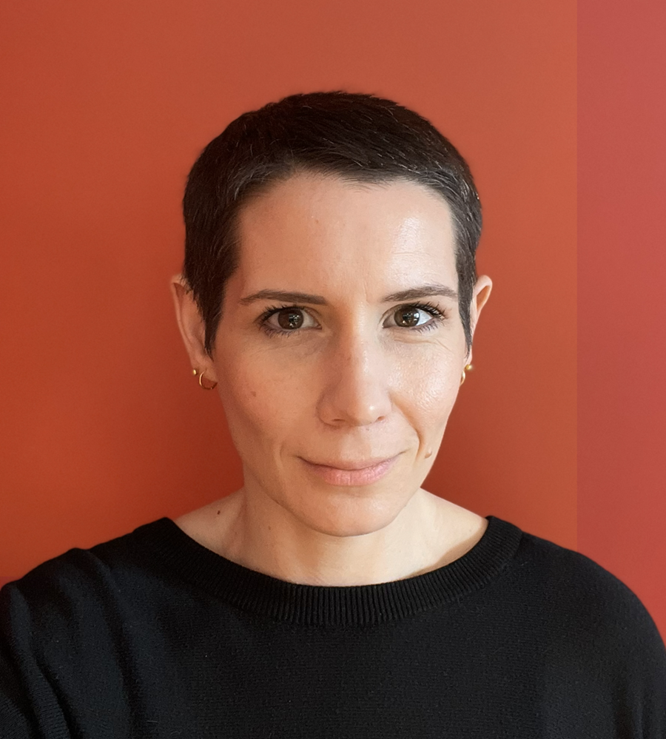
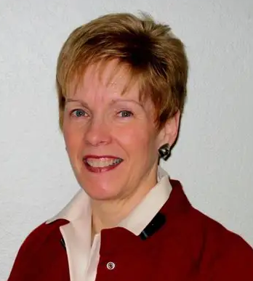

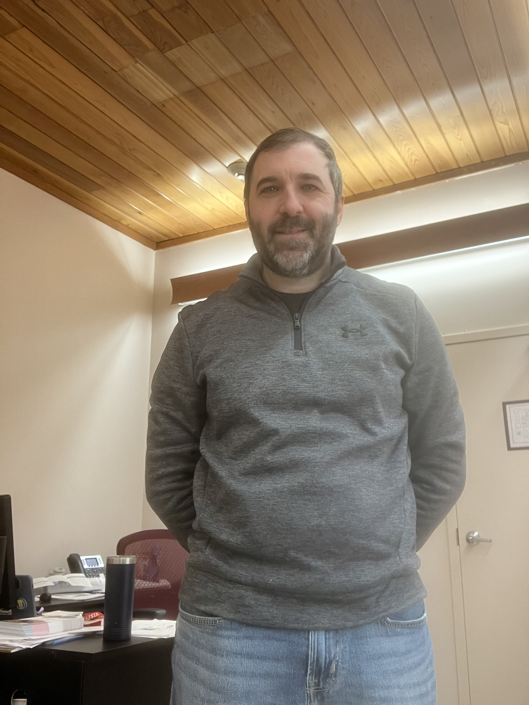
Workgroups
Housing
Transportation
Communication and Information
Melissa Davy
Assistant Town Manager
Town of Westerly
Diego Martin
Municipal Planning Fellow
Town of Westerly
Jason Lanzillo
Director of Children Services
Frank Olean Center
Ruth Tureckova
Executive Director
Frank Olean Center
Cassie Skobrak
Adult Services Librarian
Westerly Library Wilcox Park
Sue Ogle
Community Liaison
Westerly Village
Notes:
This co-chair model facilitates collaborative approach ensuring that no single organization is working alone. We have multiple sectors represented through he co chair model and supporting partners driving the action plan forward. Yale New Haven Health provides the administrative support and some of the back end work.

Slide 6
Structure
Quarterly rotation for workgroups
Chairs make the agenda
AARP Approved plan guides the work
Workgroups
Housing
Transportation
Communication and Information
Health Impact Collaborative
Notes:
There is an ongoing rotation for each work group The co-chairs drive the agendas, while Yale New Haven Health provides administrative support. This collaborative approach ensures that action steps and resources are well-coordinated across organizations.
Additionally, the Health Impact Collaborative has played a crucial role in supporting the Community Health Needs Assessment. They’ve helped with focus groups, stakeholder surveys, and ensuring we gather the right information to develop the HIS and CHIP. This data then informs and strengthens the hospital implementation strategies, which overlap significantly with the Age-Friendly Westerly AARP action plan. In essence, both groups work closely together, driving overlapping initiatives and priority areas forward.

Slide 7
Participants Include:
Age-Friendly Rhode Island
Wood River Health
Town of Westerly
St. Vincent de Paul Society
Yale New Heaven Health
Rhode Island Public Transit Authority
Frank Olean Center
Westerly Village
AARP Rhode Island
Westerly Library & Wilcox Park
Alzheimer's Association
Jonnycake Center of Westerly
Westerly Police
Healthy Bodies Healthy Minds

Slide 8
Action Plan Elements
Goal
Strategy
Action
Outcomes
Target Date
Lead Organization
Resources Needed
Status

Slide 9

Communication & Information
Panel Presentation 2/6/2025
Communication Survey, 02/2025
Community Conversation, 05/22/2025
Partnering with a University of New Haven for Intern support since 09/01/25
First and second draft of pocketbook Oct 25’ to Jan 26’

Slide 10
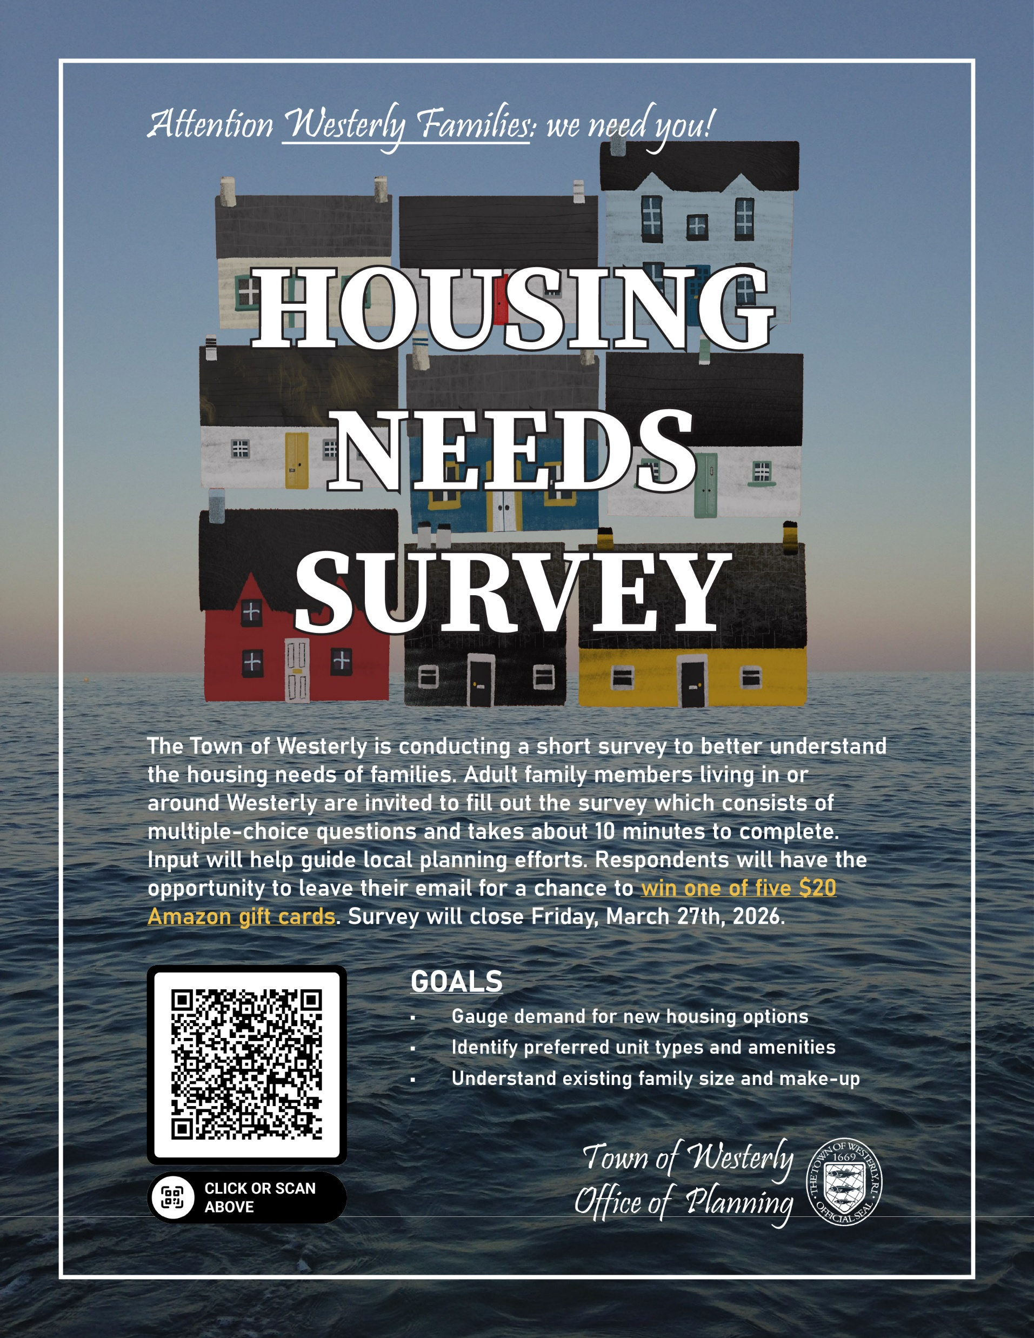
Housing
Senior Housing Needs Survey
(June 2025 - Sept 2025)
Family Housing Needs Survey
(Dec 2025 – ongoing)
The Town was awarded a $75,000 grant from RI Housing to assist with the cost of predevelopment on town-owned land (present)
HBHM Pro-Housing Project: Town staff will collaborate with HBHM to develop and implement a housing framework that centers resident voices with regard to housing production (future)
Notes:
Since June, we’ve been engaged in pre-development activities. Town of Westerly Office of Planning has been leading a broader housing needs assessment focused on three cost-burdened populations: seniors, families, and seasonal workers. Our role has been to leverage AFW network of community organizations to support outreach and ensure survey collection reaches as many as possible, to inform future affordable housing development in Westerly.
From June through September, we conducted a Senior Housing Needs Survey. One important lesson from this work was the continued need for paper surveys. While a digital option was available, many residents preferred paper copies. More than 100 completed paper copies were then uploaded into the database by our intern. That level of data entry—especially with open-ended responses—would not have been possible without that additional staffing support.
Since December, and currently ongoing, we’ve also been collecting data through a Family Housing Needs Survey to better understand what families are looking for in affordable housing. If you know families in Westerly or would like to help distribute the survey, there is a QR code available, and I’m also happy to share the link after the meeting.
Recently, the Town was awarded a $75,000 Rhode Island Housing grant to support pre-development work on town-owned land. Phase One includes environmental site assessments, land surveys, financial feasibility modeling, and economic impact analysis, among other tasks.
In addition, Healthy Bodies, Healthy Minds / Washington County Health Equity Zone are partnering with the Town on a pro-housing project. Once survey collection and pre-development work are completed—anticipated by September 2026—the goal is to present findings and final housing recommendations to the public through a resident-led engagement process co-hosted by these partners. At that stage, residents will be able to review concept designs, including site plans and renderings, and provide feedback to help shape future affordable housing development. Overall, this work reflects a strong collaborative approach, with the Town, community partners, and residents all playing a role in ensuring housing planning is informed, inclusive, and grounded in community needs.
The core focus of the PRO-Housing grant is building the structure, capacity, and framework for meaningful resident engagement. The project is connected to affordable housing outcomes (mainly development),
HBHM Pro-Housing Project:
Serving as a member of the Housing Advisory Group to guide the project
Assisting with resident recruitment and identifying or serving as a trusted entry point and messenger
Sharing community insight, priorities, and lived-experience perspectives
Supporting sharing the word with other partner organizations to gain buy-in (see below)
Leading (or co-leading) the leadership/facilitation training for Resident Leaders
Providing space for Workgroup and other meetings
Helping host or support Neighbor Talks (outreach, space, logistics, encouragement, etc.)
Participating in and/or supporting the Spring Design Lab
Staying involved through updates as this effort takes shape

Slide 11
Transportation
Asset scan of local transportation resources
Exploring and evaluating the Looking Upwards community support model
Notes:
Asset scan of local transportation resources in the community to understand what services and supports already exist.
Completed a preliminary assessment of available infrastructure and needs to inform next steps.
Exploring and evaluating the Looking Upwards community support model (a Rhode Island nonprofit focused on enabling participation and mobility for diverse populations) as a potential framework for future transportation planning efforts.

Slide 12
Lessons Learned
Backbone support is essential but not sufficient.
Local ownership and buy-in is key.
Thinking creatively about staff expands capacity exponentially. (Interns, co-chairs, etc.)

Slide 13
Appendix
https://westerlyri.gov/DocumentCenter/View/14388/Age-Friendly-Westerly-Plan-2025

Slide 14
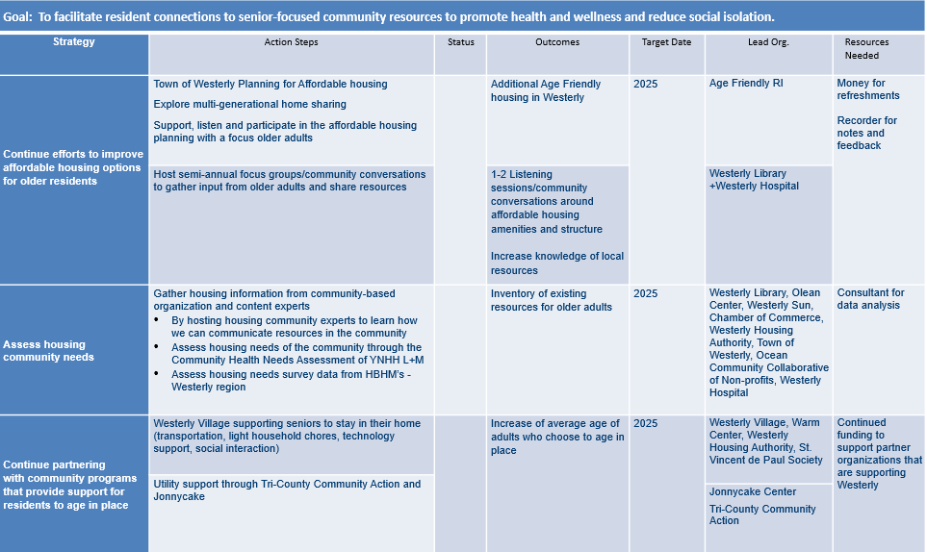
Action Plan: Housing

Slide 15
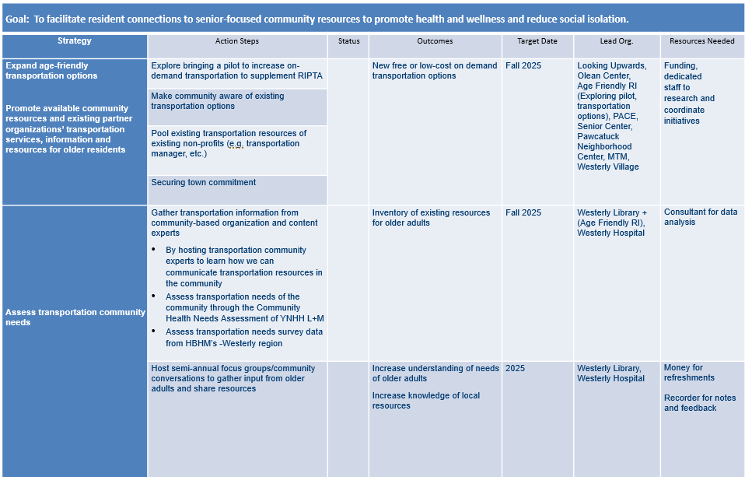
Action Plan: Transportation

Slide 16
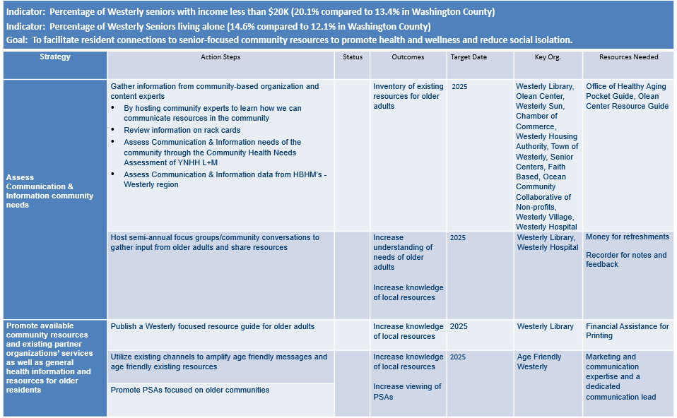
Action Plan: Communication & Information

