Slide 1
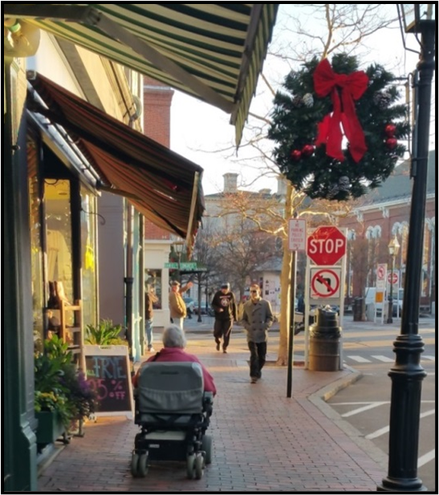


Southern NH Planning Commission
A Decade of Building Age-Friendly Communities
Presentation Elements:
Overview of SNHPC’s Age-Friendly Program, (Total of Four Phases).
Importance of Transportation and Accessibility in AF Planning
Current Focus in Building Age-Friendly Communities
Sylvia von Aulock, Executive Director
Southern New Hampshire Planning Commission

Slide 2

Why Age Friendly Communities
WE ARE ALL AGING!
We need to remind our communities about the changing needs of its residents,
To ensure people of all ages and all abilities have access to their community’s amenities,
And to plan and implement the necessary connections for people of all ages so they can live high quality lives.

Slide 3
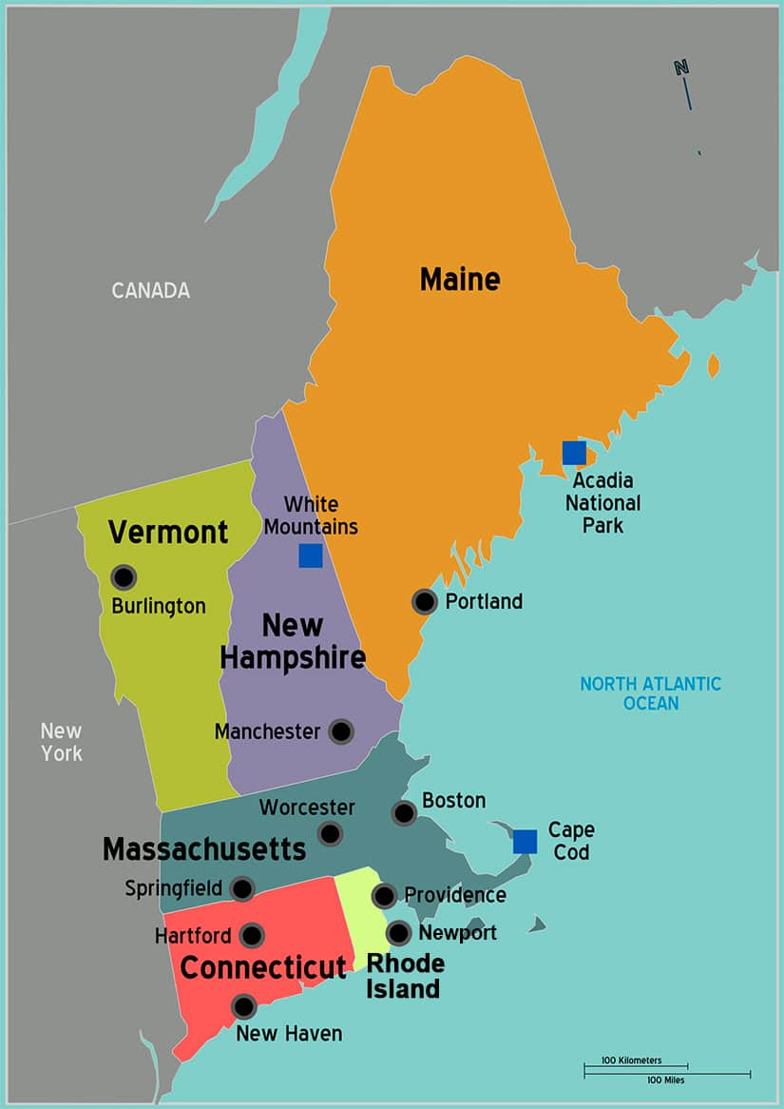
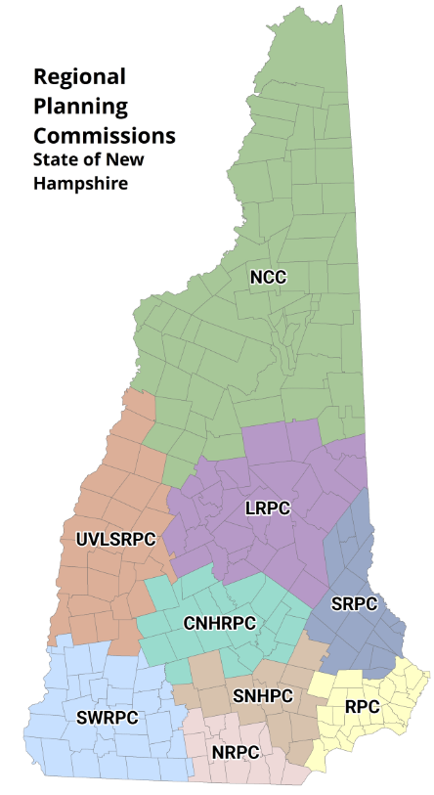
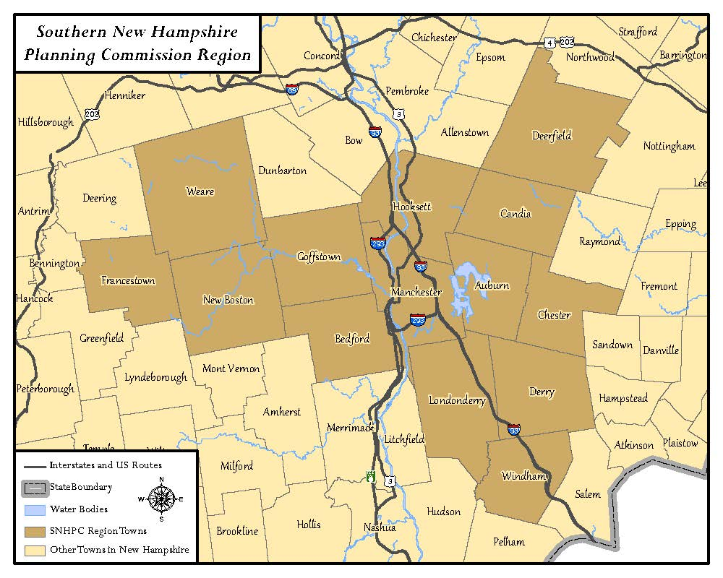
What Communities Are We Talking About

Slide 4
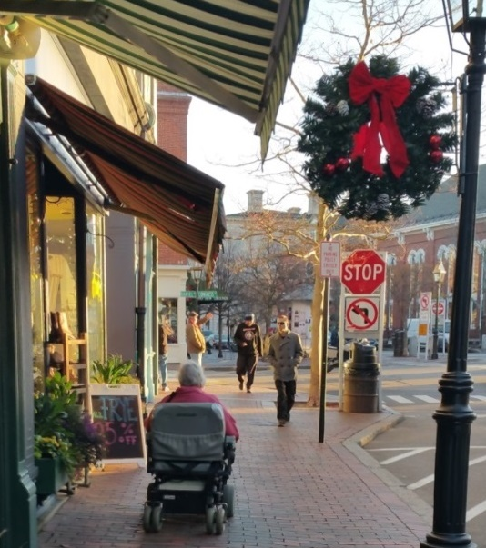

How We Began & What We Wanted To Learn
How are our communities preparing to serve the needs for the growing senior population?
How can our region/ state attract young adults?

Slide 5
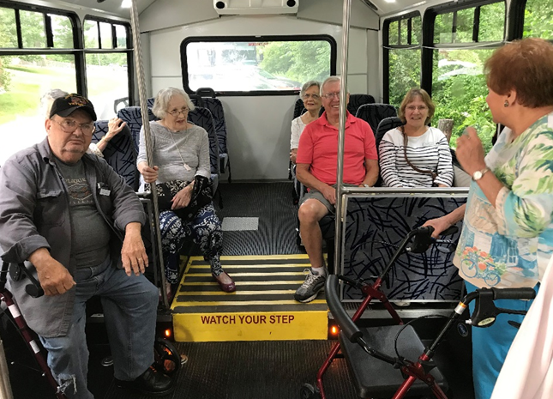
Do resident seniors/young adults know about the programs, services, and age-friendly businesses within their community and the region?

Slide 6
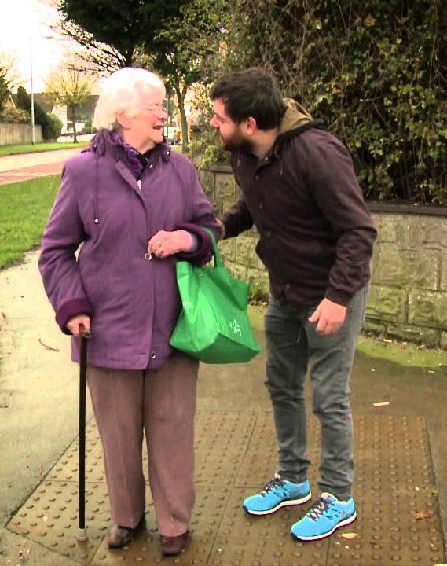
Are there synergies and opportunities between these two populations?

Slide 7
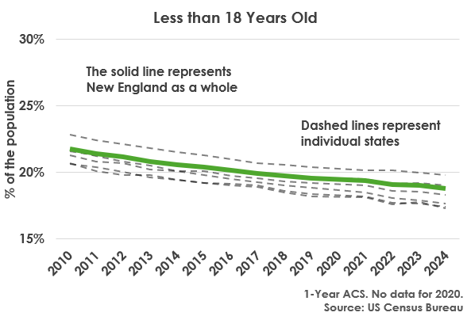
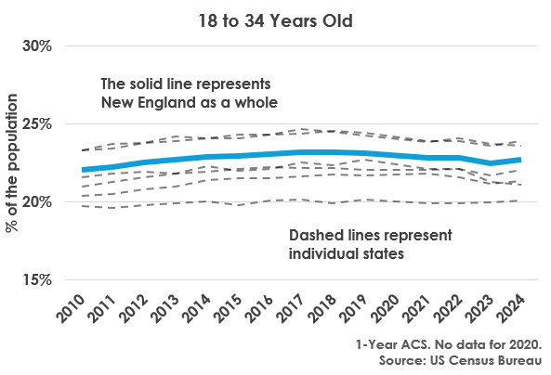
Population Change in New England
(RI, Ct, Vt. Me, NH, Mass)
Population Change - Children
Population Change – Young Adults

Slide 8
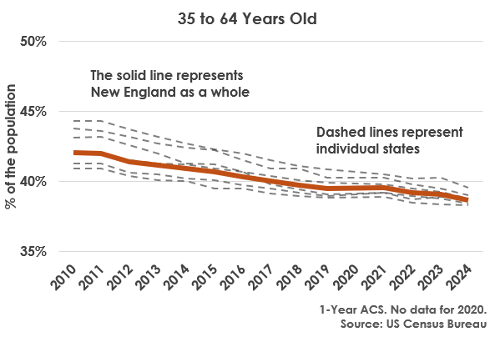
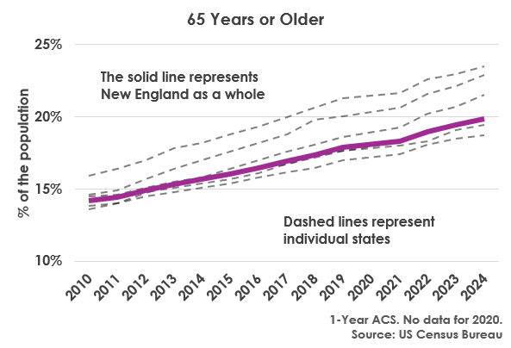
Population Change in New England
(RI, Ct, Vt. Me, NH, Mass)
Population Change - Workforce
Population Change – Older Adults
Notes:
Approximately 15.16 million people in in the six New England states, roughly 3.5 % reduction in the workforce age group is around 500,000 plus people. The roughly 5.5% increase in the older adult age group of over 800,000 people. Rhode Island has approximately 1.1 Million people. Using these average percentage changes, that around 38,500 fewer people in the workforce and 60,500 more older adults.

Slide 9

Age-Friendly Program Outreach
Community Department Reps
Involvement and Assistance
Dedicated Community and Agency Stakeholders
Discovery of Local, Regional, State, and National Partners
Students
Agency Partners
Local Champions & Volunteers
Residents

Slide 10










Supportive Partners

Slide 11

SNHPC’s Age-Friendly Program Overview
Pre-Covid
Phase I: Community Assessments (July’16-June’17)
Phase II: Pilot Programs (July ‘17- June ‘18)
Phase III: Pilots Cont. & Expanded Outreach (July ‘18- June ‘19)
Phase IV: Ongoing Work (2019- Present)
Pre-Zoom

Slide 12
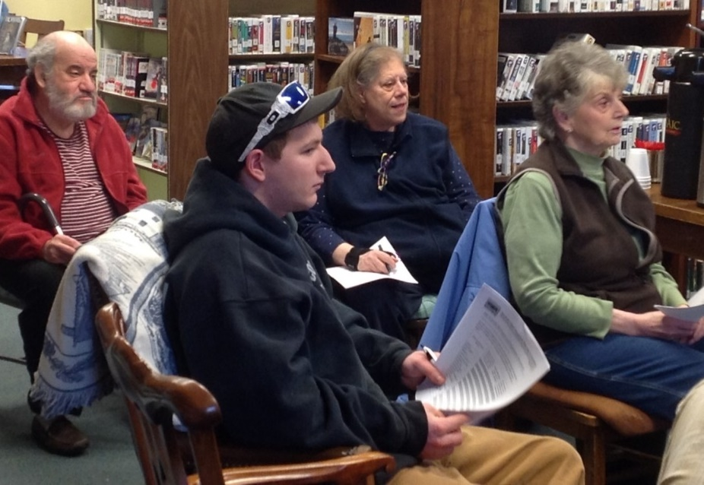
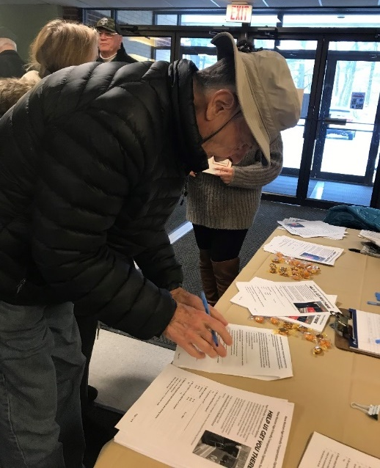
SNHPC’s Age-Friendly Program: Phase 1
Community Assessments (July’16-June’17)
Identified town assets, opportunities and roadblocks focused on community infrastructure and programming for millennials and older adults
Stakeholder Driven: Multiple Surveys & Community Conversations

Slide 13
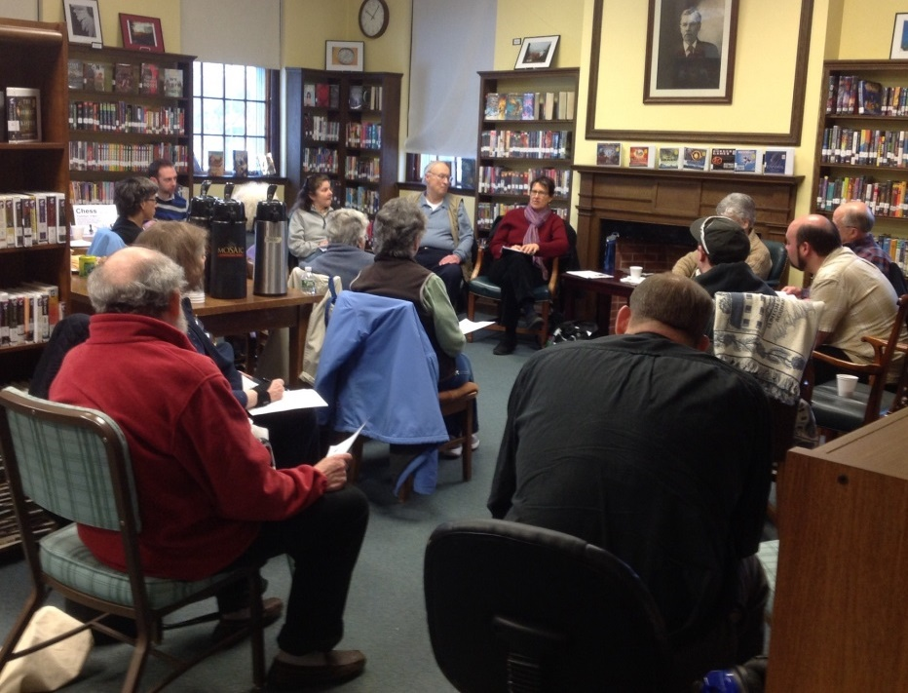
Age-Friendly Phase 1 – Community Assessments
Conversation & Survey Focus Areas
  Housing, (Trends, Needs, Diversity, & Zoning)
  Transportation, Accessibility, & Connections
  Recreation & Engagement
  Age-Friendly Businesses/Economic Development

Slide 14
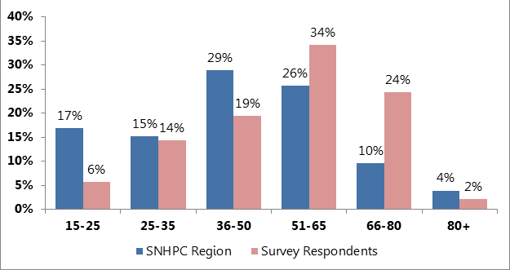
Resident Survey – Basic Findings:
What is your age?

Slide 15
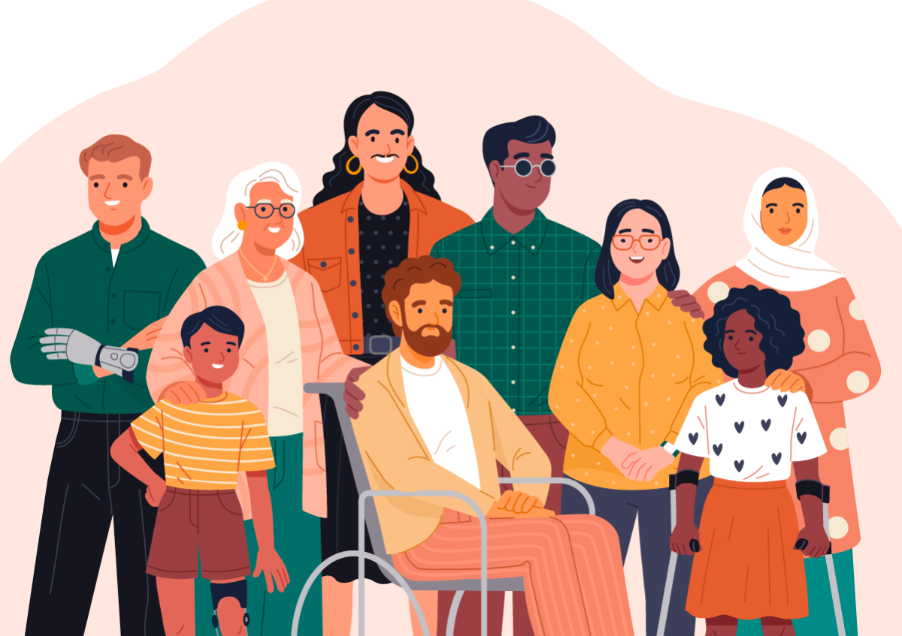
Common Concerns
“Once you’re out of the school system, you have no idea what is going on.”
“If you don’t drive, you can’t exist in this town.”
For immigrants who do not drive and can’t navigate the public transit system, “Where you live in Manchester is your America.”
“I'd love to keep living here, but there aren't really very many affordable options for younger adults.”

Slide 16
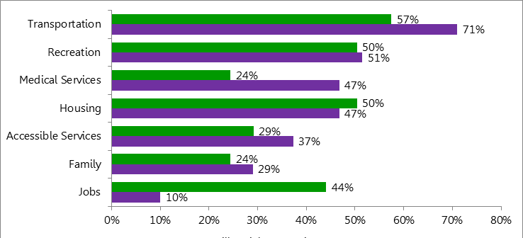
What is your Biggest Concern as you Age in New Hampshire?
Senior
Millennial

Slide 17
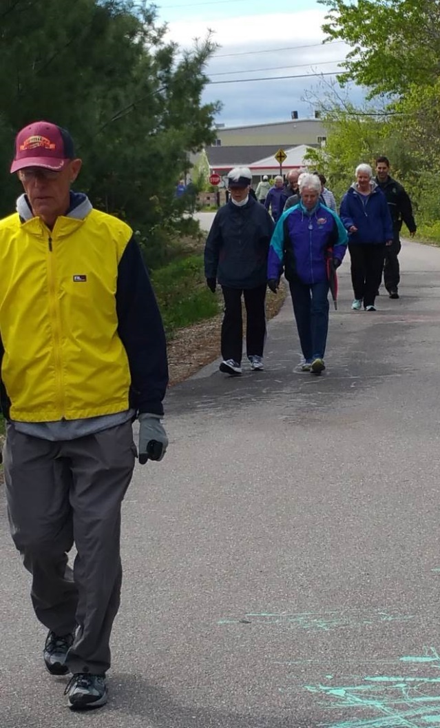
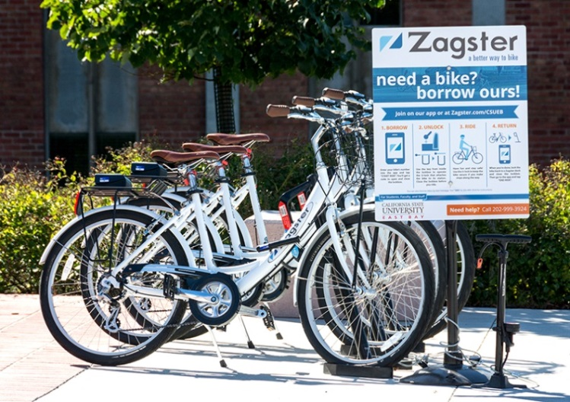
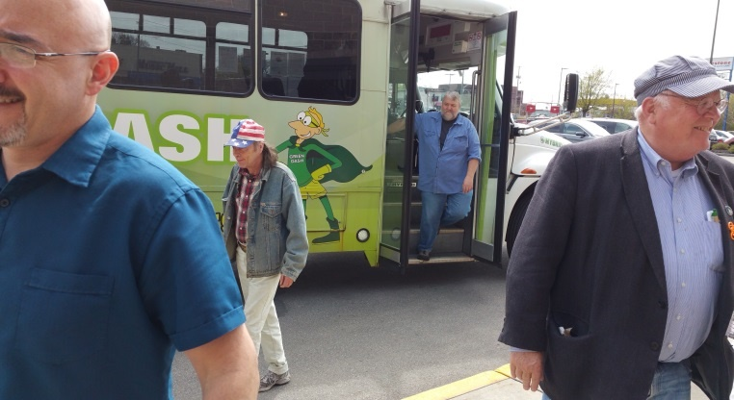
Phase I Cont. - Community Conversations
What We Heard –
What Works Well for Transportation Services
Trail Network
Bike Sharing (went out of business post Covid)
Public Transit (in urban areas only)

Slide 18
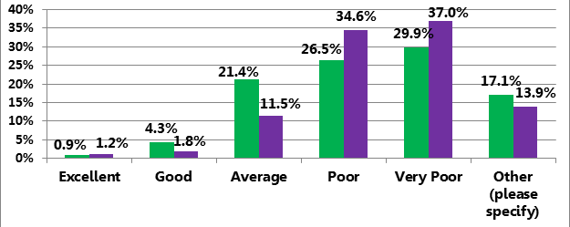
Phase I Cont. - Community Conversations
What We Heard: Roadblocks for Transportation
“If you don’t drive, you can’t exist in this town.”
How would you rate your community’s
transportation options if you were unable to drive?
Millennials
Seniors

Slide 19
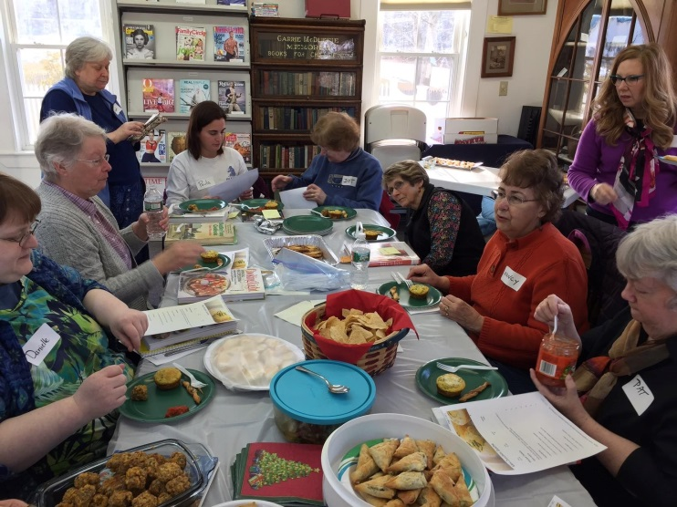
Phase I Cont. - Community Conversations
What We Heard –
What Works Well Recreation and Engagement
Libraries and some Recreation Departments are now default Community Centers
Allowances to Utilize Venues
Unique Partnerships
Community Commitment to Outreach (monthly newsletters)
Community Champions

Slide 20
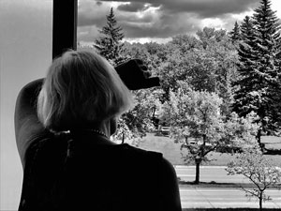
Phase I Cont. - Community Conversations
What We Heard:
Roadblocks for Recreation and Engagement
Community lacks connections, one place to find out what is happening in town
No senior center and limited support for community programs
Not enough meeting space, no shops or places to meet with friends
We cannot expand to growing needs (library, school, recreation, parking…)
Isolation

Slide 21
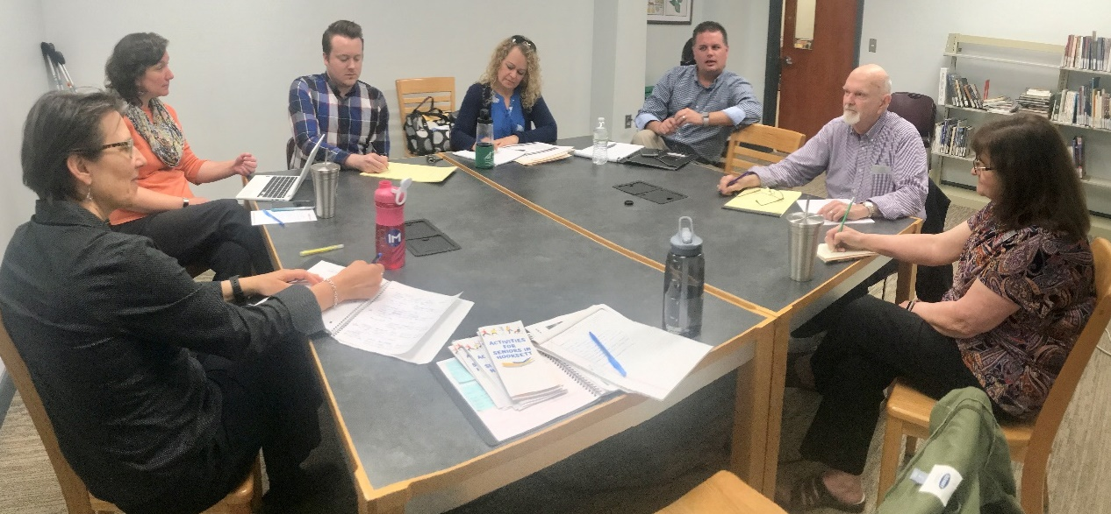
SNHPC’s Age-Friendly Program: Phase II
Phase I: Community Assessments (July’16-June’17)
Phase II: Pilot Programs (July ‘17- June ‘18)
Utilizing findings from community assessments, SNHPC invited communities in the region planning assistance to advance the concept of Age-Friendly Communities

Slide 22
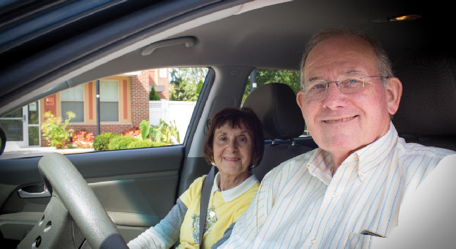
Phase II: Community Pilot Projects Possibilities
Potential Projects
Adding AF components to a Community Master Plan
Developing AF outreach materials, providing information to older adults
Facilitating Multi-Agency Transit Service Outreach
Identifying Innovative Zoning Opportunities, i.e. creating AF Neighborhood Zoning Allowances
Recruiting volunteer drivers for local Volunteer Driver Programs

Slide 23
Community Selection Process
SNHPC’s Age-Friendly Program: Phase II Process
Pilot Program Application Questions:
Has the community appointed a project leader for the Pilot Program?
What elements of the community assessment will the community focus on?
How will the community utilize the program for future planning efforts?
Is the community interested in AARP Age-Friendly Network?
Which population will the community focus on? (millennials, seniors, or both)

Slide 24
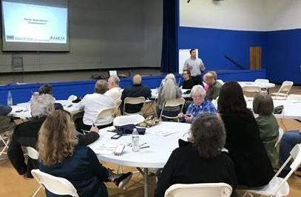
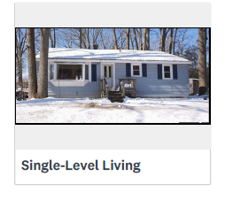
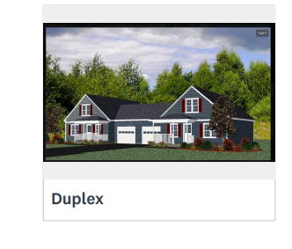
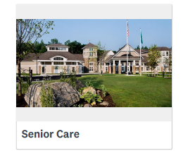
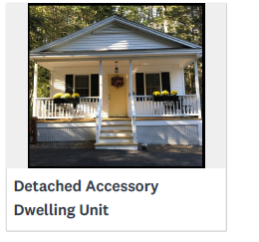
SNHPC’s Age-Friendly Program: Pilot Program - Housing
Community Housing Discussion
Explore alternative housing types (single-level living, shared amenity style housing, micro units, conversions, ADU’s, etc.).
Review existing zoning regulations with the intent of developing Age-Friendly housing regs
56.5 %
52.2%
60.9%
43.5%

Slide 25

What Would an Age-Friendly Subdivision Look Like?
SNHPC’s Age-Friendly Program: Housing
Purpose:
To encourage builders to build housing that meet the needs of Chester’s citizens. These age-friendly neighborhoods are envisioned to consist of smaller, affordable, low-maintenance homes for all people regardless of age or ability.

Slide 26
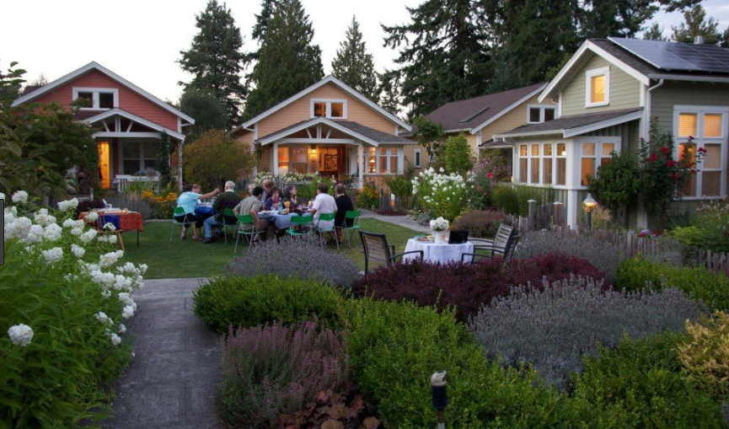
SNHPC’s Age-Friendly Program: Housing
Age-Friendly Neighborhood Zoning Allowance
Single Family or Duplexes
Max. square footage – intent to create smaller units (ie 1200 s.f. total unit size)
Master Bedroom with bath on ground floor
Universal design components required
Allowance for density bonus
Encouraged to include shared drives, infrastructure, and amenities

Slide 27
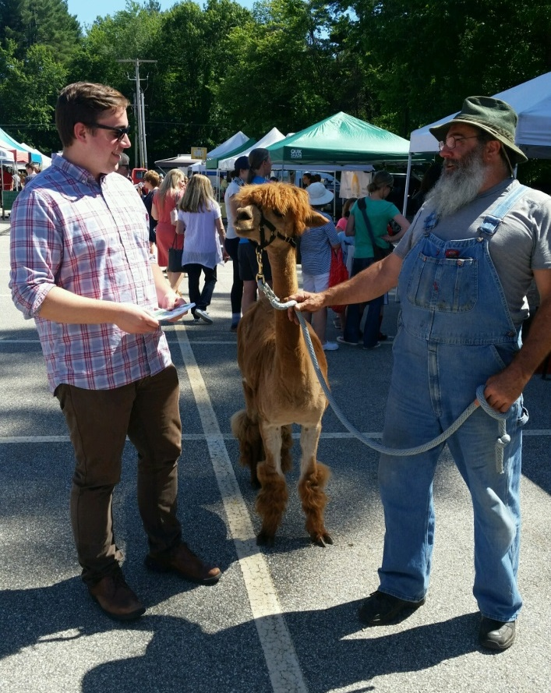
SNHPC’s Age-Friendly Program: Master Plan Assistance
Incorporation of Age-Friendly Strategies:
Complement Master Plan Update
Community input via online survey
  Survey residents at local events (farmer’s market, grocery stores, etc.)
  10 weeks almost 800 participants
  Develop recommendations for Master Plan update based on survey results

Slide 28
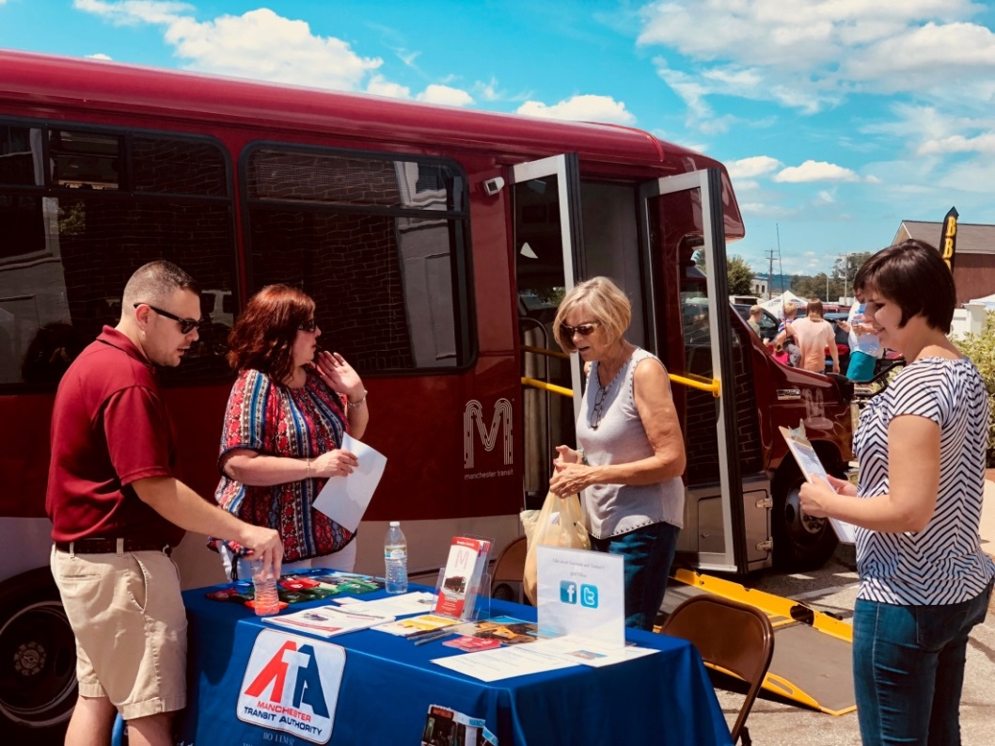
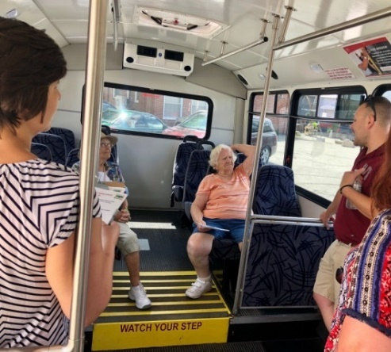
Phase II: Transit Outreach and Collaboration
Foster partnerships including Library, Recreation, Town Officials, local transit, other agencies (YMCA), and residents.
Local Transit “Touch the Bus” event during Old Home Day, Goffstown, NH

Slide 29
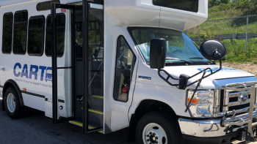
Phase II – Community Transportation Surveys
Transportation Survey
Question: Are you aware of the transit program in your community?
Population: 5,300

Slide 30
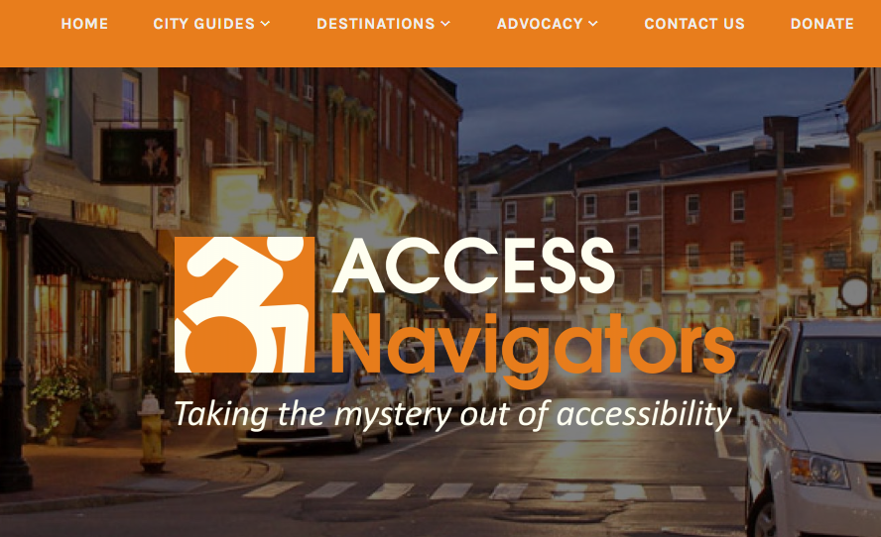
Phase II Partnerships: Access Navigators
https://accessnavigators.com/

Slide 31
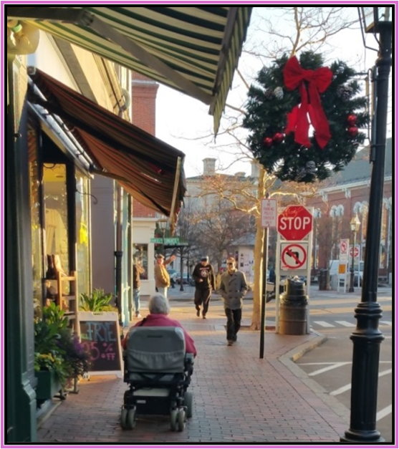
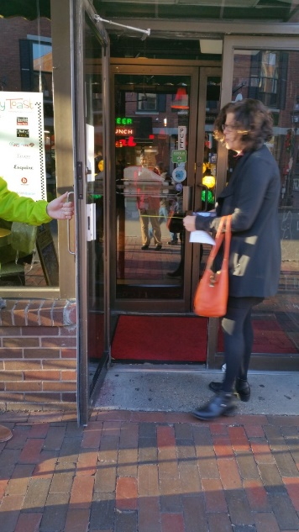
4 Things to Look for on Site Visits
Phase II : Accessibility Focus
Is parking accessible to entry?
Can you get into the door?
  32” wide, has flat surface or ramp
Can you use the facility with ease?
  Tables spaced apart
  Paths free of obstructions
Is the bathroom accessible?
  Flat entrance, sufficient area
  Elevator-accessible if on different level

Slide 32
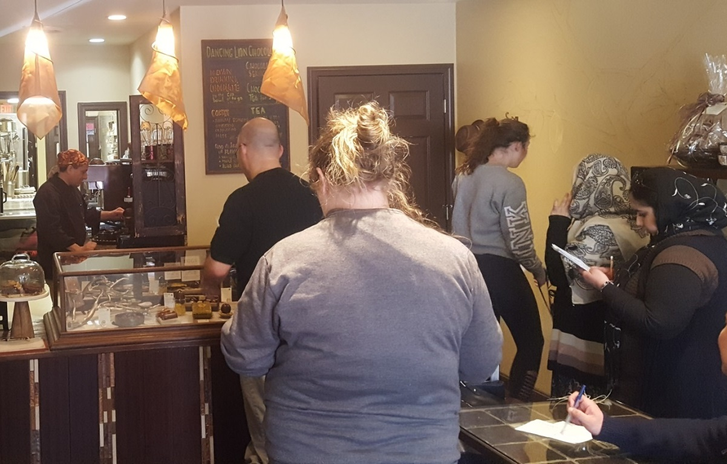
Downtown Manchester Business Surveys
Phase II Partnership with SNHU
SNHPC staff worked with students and willing businesses to conduct age-friendly business surveys.

Slide 33
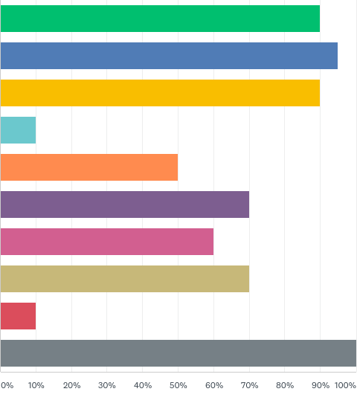
Phase II Partnerships: Library Assessments
Which accessible features does the library provide?
Flat entryway
Wheelchair accessible
Non-slip surface
Transportation Options
Delivery of library books
Curbside book-drop
Tactile surfaces
Easy-to-read signage
Braille signage
Accessible bathroom w/ bars
50%

Slide 34
SNHPC’s Age-Friendly Program: Phase III +
Phase I: Community Assessments (July’16-June’17)
Phase II: Pilot Programs (July ‘17- June ‘18)
Phase III: More Pilots + Expand Scope (July ‘18- June ‘19)
Continue with pilot program and raise awareness about age-friendly issues and planning in the region and state
Continued Age Friendly Planning Efforts (ongoing)
Continue working with agency partners on various transportation related elements (travel training, outreach and education, encouraging age-friendly planning be incorporated in community master plans

Slide 35
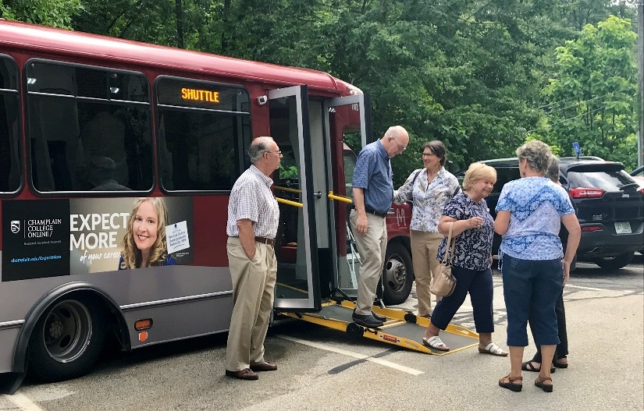
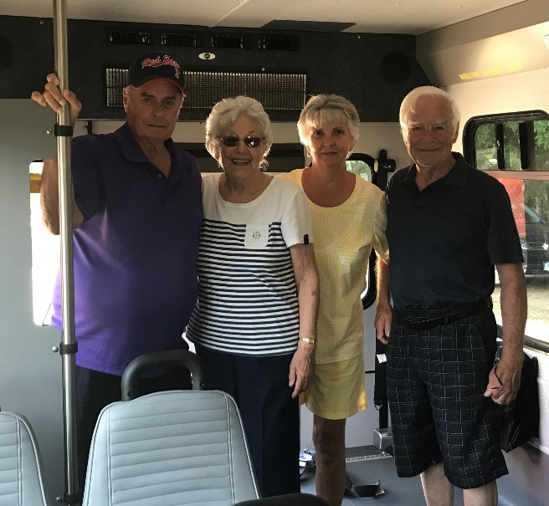
Transportation Awareness
Local Transit visits community seniors during their coffee hour for a meet and greet.

Slide 36
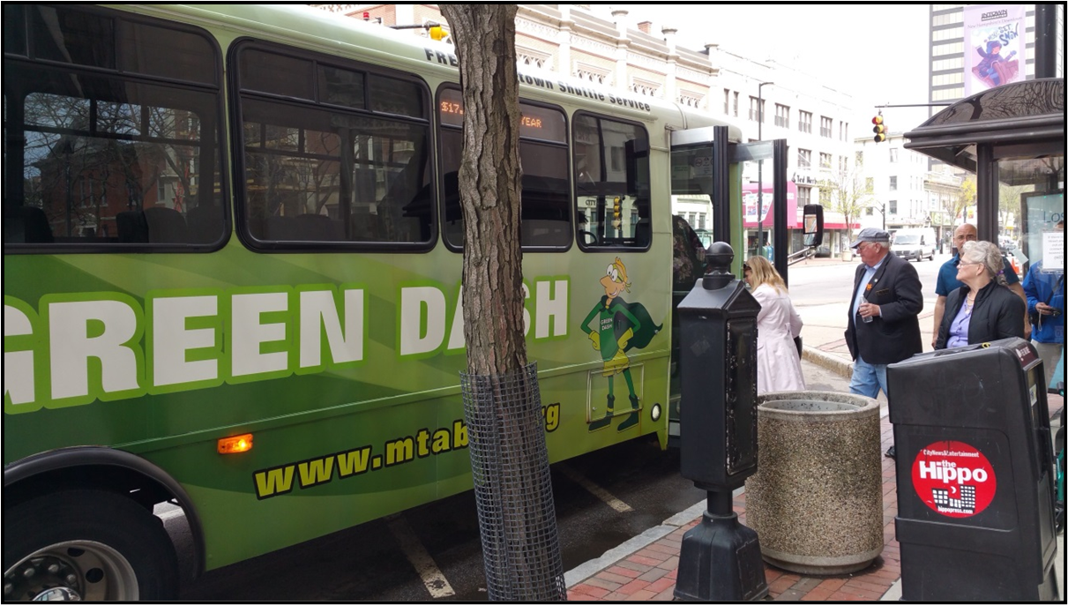
Community Transportation: Lessons Learned
Create a fun info session including a touch the bus event & include giveaways or treats
Coordinate with service provider partners to use festive transit services i.e. Beach Bus, Christmas light tour…
Consider creating a transit training program collaborating with transit and other agencies
Assess and update the community’s website on how transit options are listed
Partner with the local bus service, Community’s Parks and Rec. Dept, Senior Center and sponsor a local trip

Slide 37
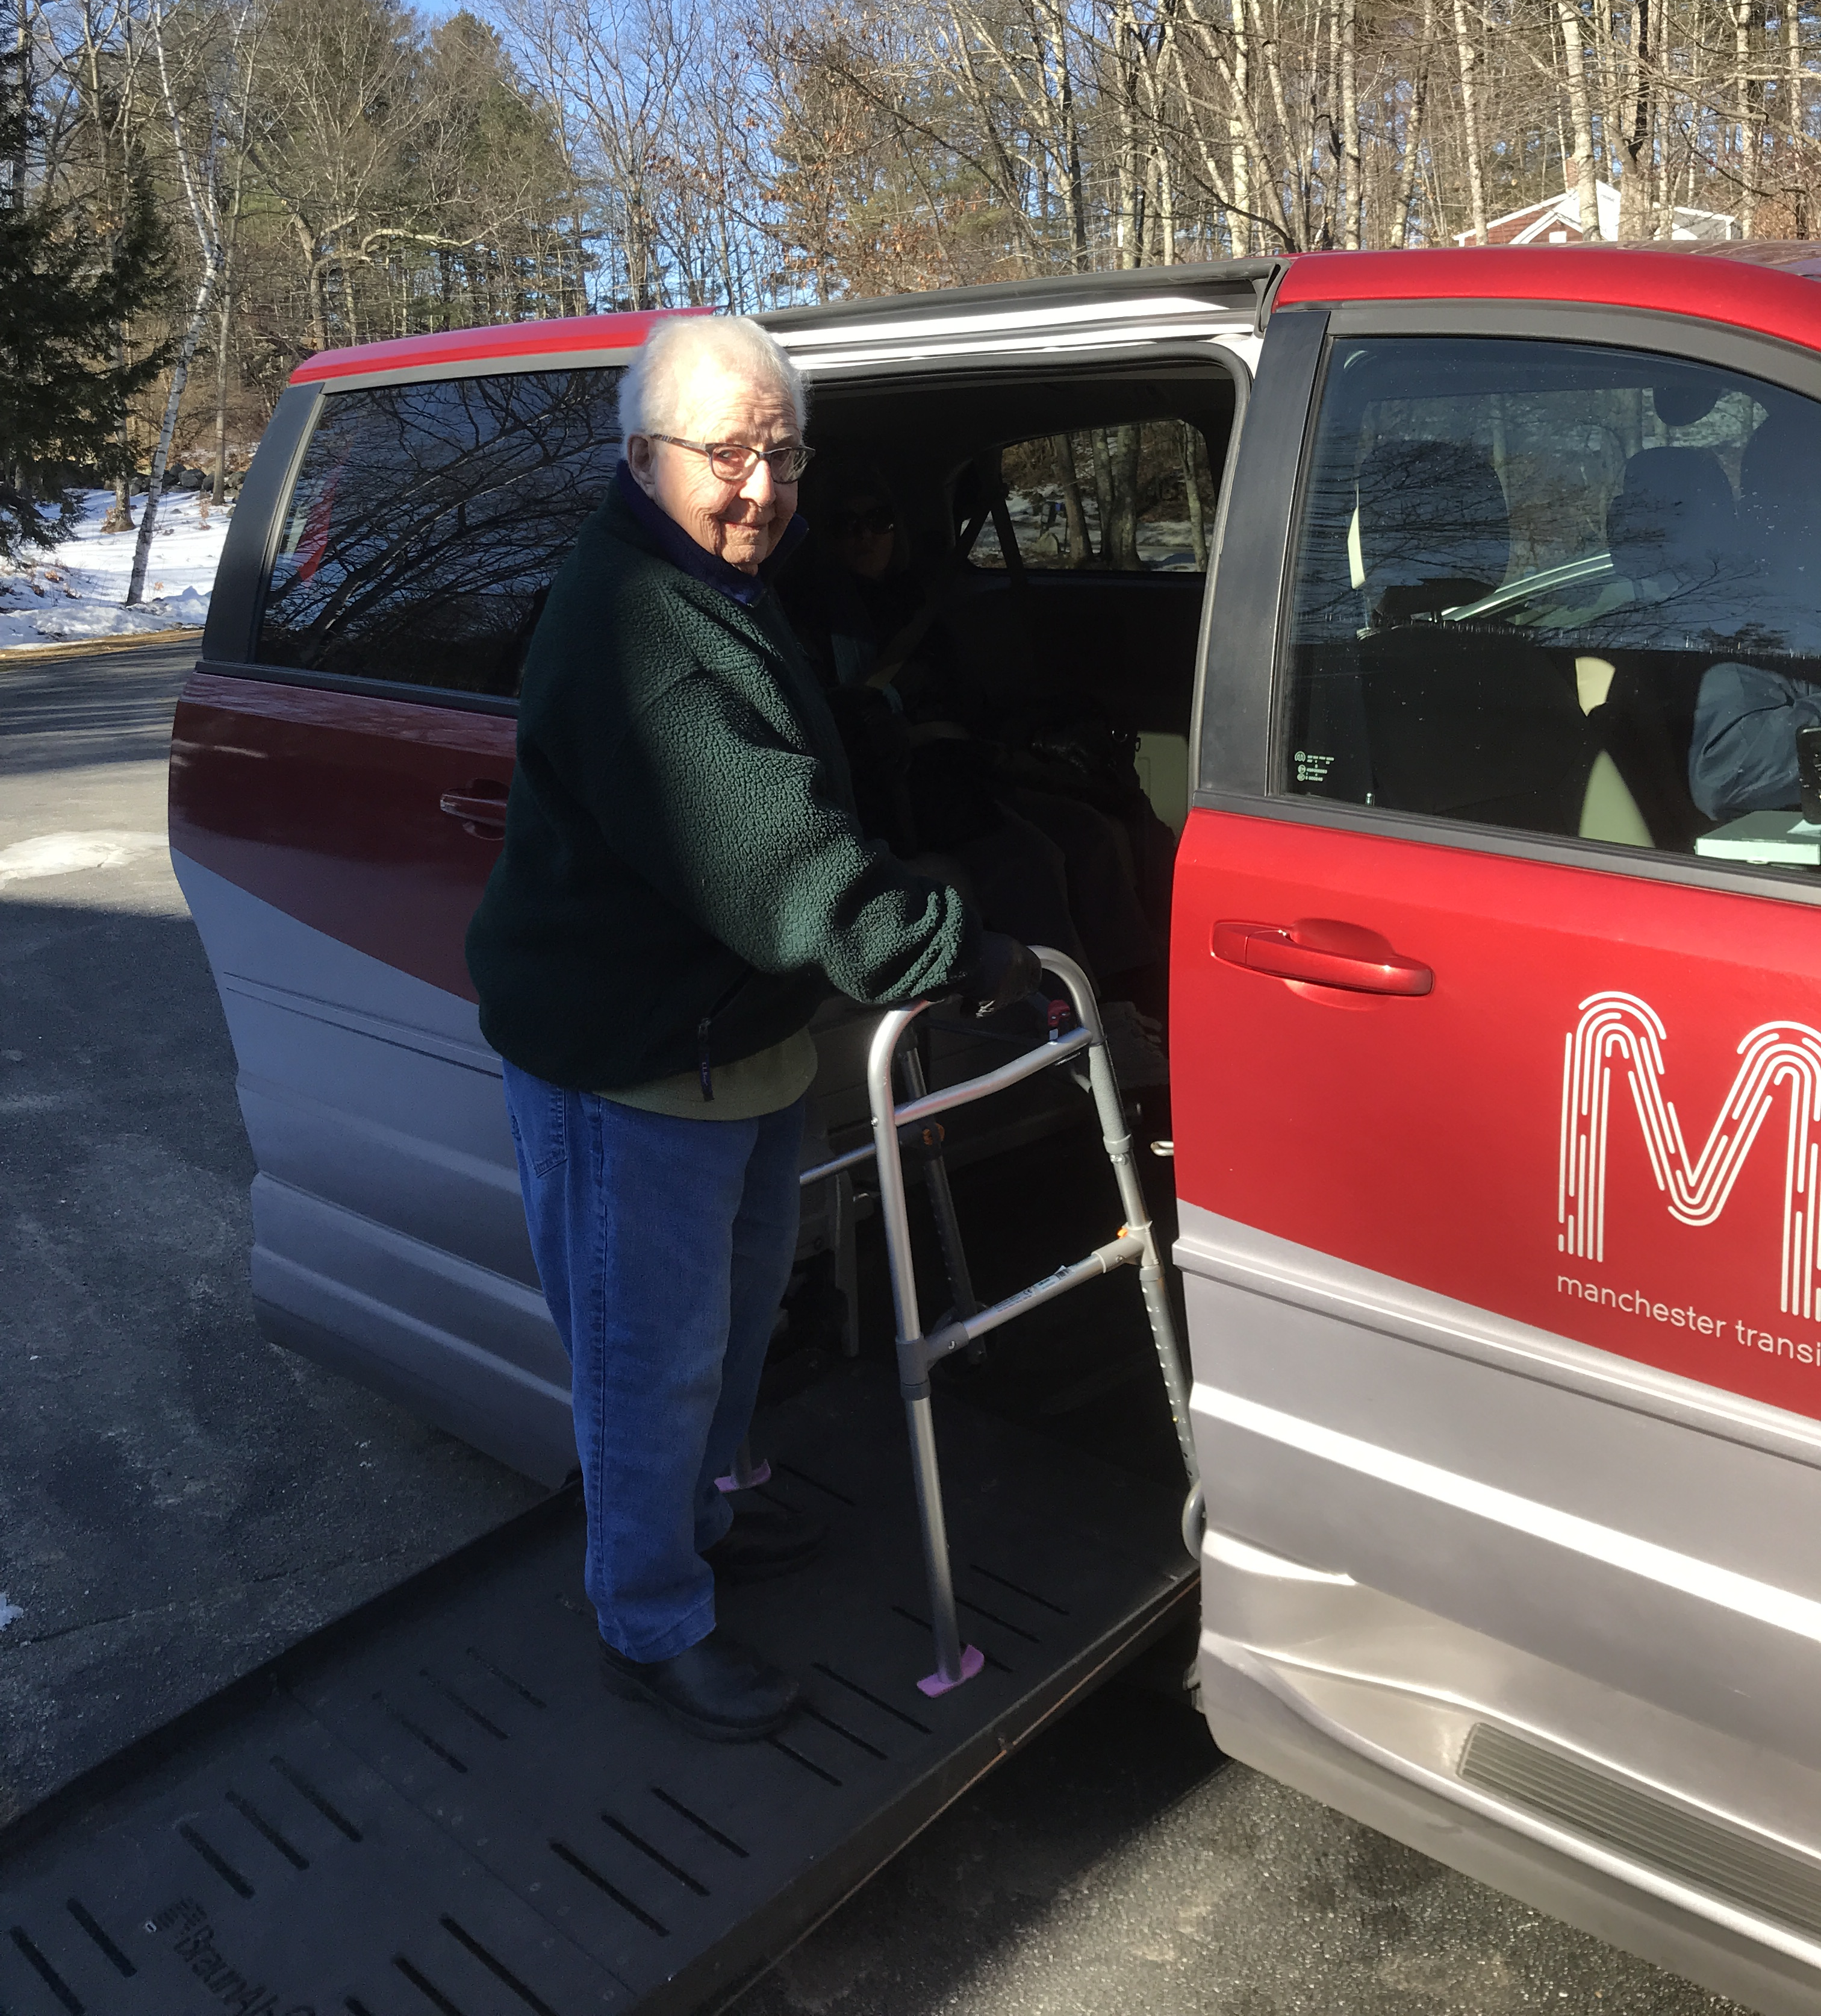
Current Focus on Creating Age Friendly Communities
“Many things I do now at 68, I will not be able to do safely as I age.”
Building on Awareness Initiatives
Local Transit & Developing a Transit Training Program
  Outreach to local senior center and Easterseals Vets Count Program
NH SCOA & Involvement in Statewide Community Transportation Needs Assessment
AHA & Building Relationships with VDP
  Assisting with volunteer driver recruitment
AHA & DEI Pilot Program with Victory Women of Vision

Slide 38
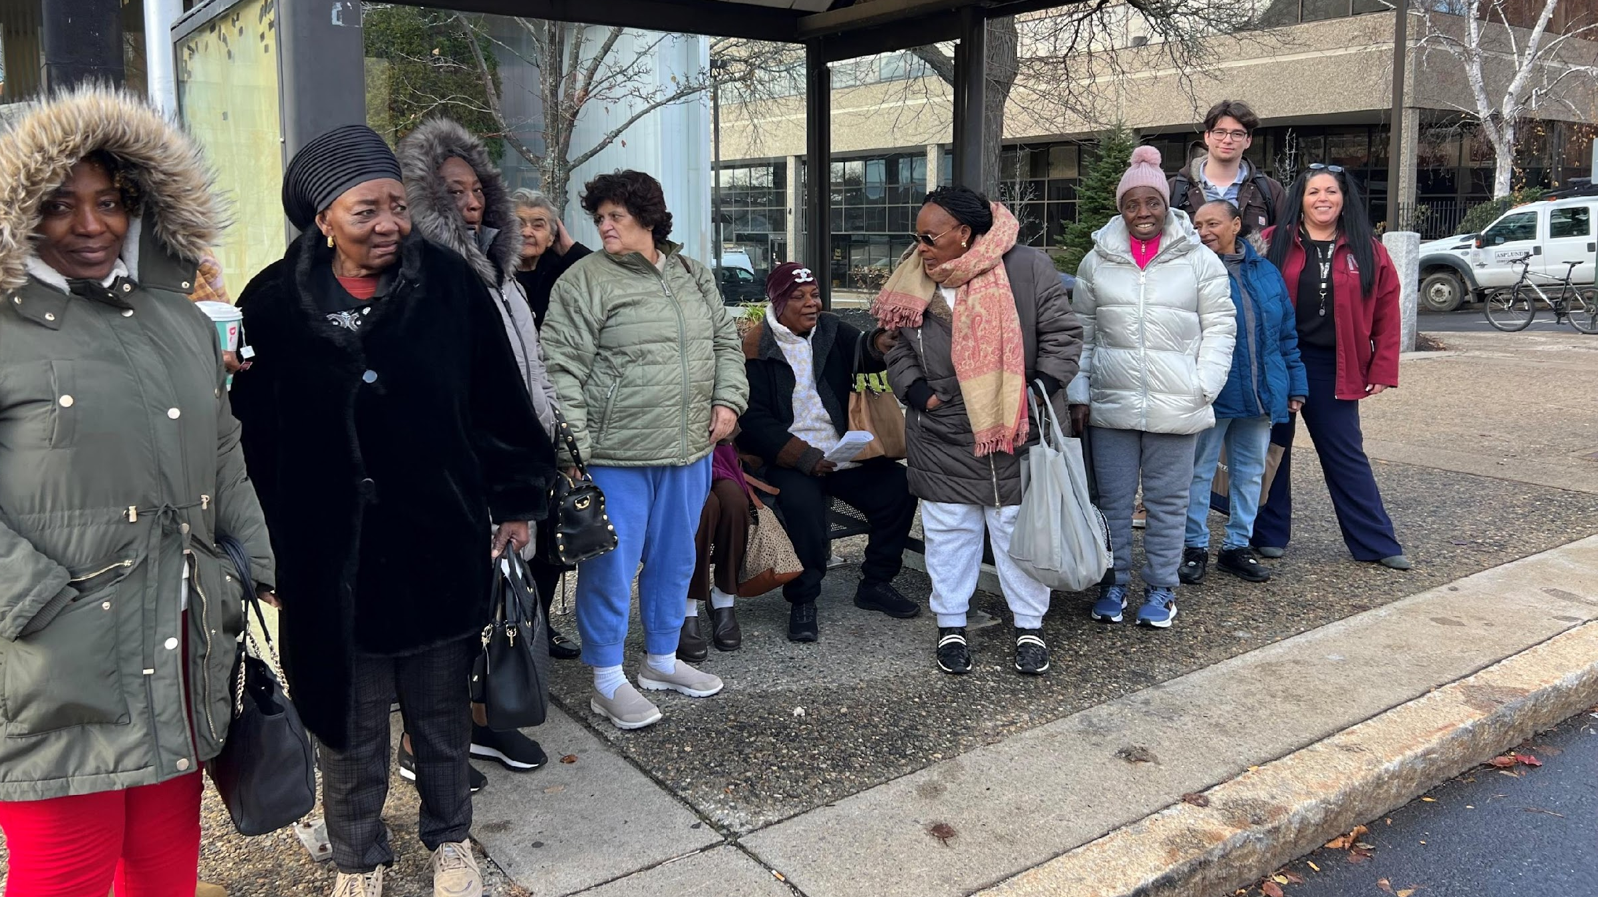
How Bus Doors Open the Path Towards Independence
Pilot Program with Victory Women of Vision in Manchester, NH

Slide 39
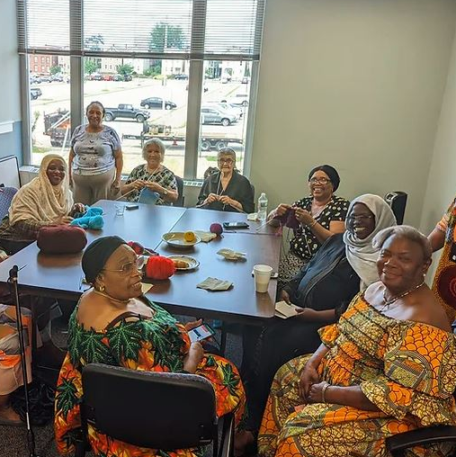
Pilot Project: Meet Victory Women of Vision
VWV’s Mission
To encourage, empower, and nurture immigrant and refugee families to thrive by embracing their cultural heritage as they build their new lives

Slide 40

Discovery of Language Challenges
Ukraine
Albania
Sudan
Virgin Islands
Nigeria
Ethiopia
Congo

Slide 41
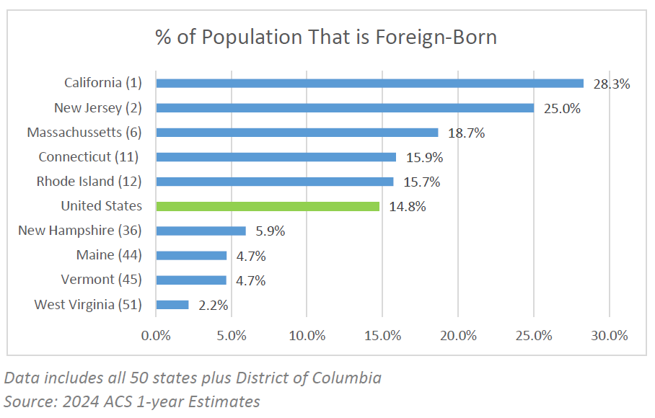

Slide 42

Conversations With Elders:
What We Asked
What is and is not working well in your community as it relates to aging?
How can New Hampshire better serve and support its aging population?
What do you need to continue living in your home as you get older?
What can we do to reduce isolation for older adults in New Hampshire?

Slide 43
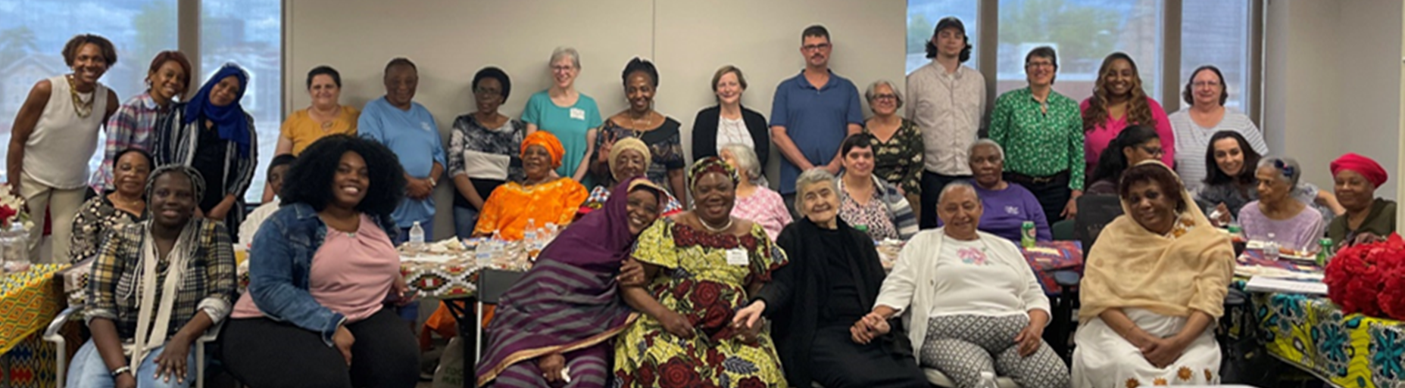




Needs and Focus Areas
Elder Project Coordinator
Healthcare
Housing
Transportation

Slide 44
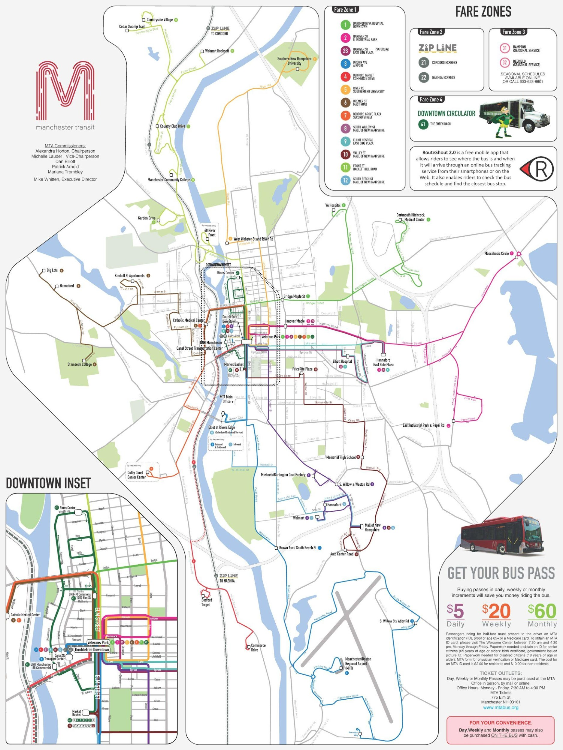
Demystifying Transit Services
Navigating the local bus system for the first time can be overwhelming.
Language barriers and concerns over getting lost, fear of safety, worries over space and cleanliness, accessibility concerns, all amplify these challenges of riding the bus for the first time.

Slide 45
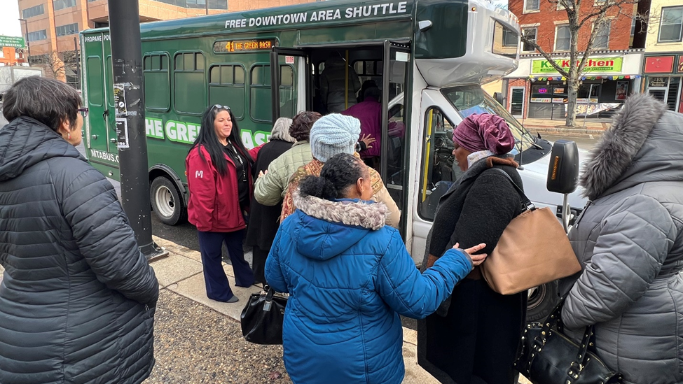
Elders’ First Ride: The MTA Green DASH

Slide 46


Slide 47

Lessons Learned
Know the number of participants prior to the event.
Elders can come from anywhere around the globe so outreach materials need to be versatile.
Elders may be too embarrassed to disclose physical issues or other needs.
Cold NH weather can be a problem for many elders whose country of origin has much more moderate climates.

Slide 48
Unexpected Results
Some Elders are working with staff to learn the bus system.
Several elders are now utilizing job training programs.
They are enjoying newly found freedom to go shopping.
As one said, “I no longer have to beg my family for rides.”

Slide 49



Shared Stories: https://www.youtube.com/watch?v=vlOQpYN7xnM&t=8s
“I love this city, there are so many places I’ve never seen in this city, and the bus showed me those places.”
“It’s really good for my family. They feel that I’m independent now. I can do stuff by myself.”
“It really means a lot. It feels good that I can go wherever I need to go.”

Slide 50

Building on Momentum
Working with local transit on creating a viable bus buddy program.
Continue to work with VWV on empowering elders to ride the bus - next stop the Beach!
Coordinating with other social service providers on ensuring transportation options are understood.

Slide 51



Manchester Transit Beach Bus
Everyone had a blast!
Some have lived in New Hampshire for decades and had never been to the beach.
As we build our relationship, we are building trust
Already started planning to take the next beach bus.

Slide 52

Thank You!
Southern NH Planning Commission
A Decade of Building Age-Friendly Communities
https://www.snhpc.org/233/The-Becoming-Age-Friendly-Program
Sylvia von Aulock
Executive Director, SNHPC
svonaulock@snhpc.org
603.669.4664

